Slide 1


Slide 2
Using your Web Browser,
Open this URL:
Click on the workshop you’re attending, and find:
1
http://mlhlocal.host/lhd-resources
2
Setup Instructions
The Code Samples
A demo project
A Workshop FAQ
These Workshop Slides
More Learning Resources
Notes:
What to Say:
Tell attendees we are going to check them in for the event
Once attendees check in, they will receive an email with the items listed on the slide
Attendees must check-in to get credit for attending this event
What to Do:
Confirm that everyone has checked in by asking participants to give you a signal when they receive the email.

Slide 3

Our Mission is to Empower Hackers.
65,000+
HACKERS
12,000+
PROJECTS CREATED
400+
CITIES
We hope you learn something awesome today!
Find more resources: http://mlh.io/
Notes:
What to Say:
Major League Hacking (MLH) events are meant to bring hackers together so they can learn, build, and share.
Give participants a brief overview of Major League Hacking (MLH).
Tell participants they can learn more at http://mlh.io/
Example Talking Points:
TODO
Through Localhost MLH is rethinking technology education to reflect how hackers actually learn and how fast the industry moves.
Here’s some quick facts about MLH:
Each year, MLH supports over 65,000 hackers around the world at events they facilitate
Those students create more than 12,000 amazing projects together
MLH is a global organization that empowers hackers in more than 400 cities and growing every day

Slide 4
What will you learn today?
1
What makes the Ada programming language special & why you should use it.
2
How to write bug-free code with a provable subset called SPARK Ada.
3
How to implement the Stack Data Structure in SPARK Ada.
Notes:
What to Say:
Explain to participants what they will learn today
Learning is a core part of being a hacker and today they are going to learn something new
What to Do:
Get participants excited about the experience.

Slide 6
Meet the Ada programming language!
Ada is a general purpose, modern programming language like Java, C, or C++.
Ada’s creation was sponsored by the USA’s Dept. of Defense (DoD) in the 1970s and 1980s.
The goal of the Ada programming language is to give developers the tools necessary to write safer, more maintainable code.
Ada
01
02
03
04
05
06

Slide 7

Ada vs. C, C++, & Java
In high reliability software, you are usually choosing between C, C++, Java, and Ada. So, why Ada?
What is Ada good at?
Ada is a mature language that enables you to write efficient code on a variety of platforms. It’s known for its:
Reliability
Maintainability
Testability
Formal Proofs (Bug-Free!)
Human-Friendliness
Ada’s Key Value
Unlike C, C++, and Java, Ada can actually help you write more reliable and maintainable code.

Slide 8



When would you want to use Ada?
You could use Ada for just about anything, but it’s especially useful for writing...
High-Integrity Embedded Systems
Long-Lived Applications
Apps where Human Lives are at Stake
Planes, trains, spaceships, boats, etc.
Applications that need to last for 20+ years.
Autonomous cars, railroad signals, etc.

Slide 9








Who uses Ada?
Ada is used by both big & small organizations to write
mission critical software that is bug-free!
And so many more...

Slide 10

What is AdaCore?
AdaCore creates tools for developers to write safe and secure software.
http://www.adacore.com/
AdaCore was founded in 1994.
AdaCore has over 100 employees in the US, France, UK, and Estonia.
AdaCore’s products are used in many “high integrity” industries (Military, Space, Railroad, Automotive, Aviation, etc.)
AdaCore loves empowering hackers & sponsoring these workshops!

Slide 12

Let’s take a quick tour of SPARK Ada.
We’re going to cover the language at a high level:
If you’re familiar with C, C++, or Java, Ada will look very familiar.
Our goal is to enable you to write your first Ada program!
We’ll also cover some useful SPARK specific features.
Fun Fact: Ada was named after Ada Lovelace, the first programmer!

Slide 13
Hello World.
The first program we usually write in a new language
is “Hello World”, which just prints those words.
So, what is this code doing?
Line 1: Import the Ada.Text_IO package then make its namespace immediately visible.
Line 2 - 3: Define a new procedure called “Main”.
Line 4: Print the string “Hello, world!” to the console.
Line 5: Close the procedure.
Ada uses keywords rather than symbols (‘{ }’) to define scope.
01
02
03
04
05
06
with Ada.Text_IO; use Ada.Text_IO;
procedure Main is
begin
Put_Line ("Hello, world!");
end Main;

Slide 14
Data Types.
Your programs will need to interact with data.
What types does Ada have to offer?
Built-in Types:
Ada has a number of built-in data types that you can use in your programs. Today we’ll be using:
Integer
Character
String
Boolean
Custom Types:
You can also create your own types.
01
02
03
04
05
06
type My_Integer is range 1 .. 10;
type RGB is (Red, Green, Blue);

Slide 15
Variables & Assignment.
You’re going to need some place to store data in your programs. Variables hold data & allow you to access it.
Assignment
Assignment statements are written as name := value. For example, X := 10; sets the variable X to 10. Initialization
Variable initializations use the following format:
[NAME] : [TYPE] := [VALUE];
For example: A : Integer := 10;
Naming
In Ada, variable names are case insensitive. HELLO is the same as Hello is the same as hello.
Note: = vs. :=
In Ada, the = (single equal) is for comparison and := is for assignment.

Slide 16
Strong Types.
Ada is a strongly typed language which means that variable types are predefined and do not change.
Declaring Variables.
Since Ada is strongly typed, we need to declare variables up front.
Mixing Types.
Since Ada is strongly typed, you can’t combine objects of different types without explicit conversions.
01
02
03
04
05
06
declare
X : Integer := 10;
begin
Do_Something (X);
end;
01
02
03
04
05
06
Len_1 : Miles := 5.0;
Len_2 : Kilometers := 10.0;
-- This would cause an error!
D : Kilometers := Len_1 + Len_2;

Slide 17
Control Flow.
Ada comes with a variety of control flow structures. The two we’ll be looking at today are if statements and for loops.
If Statements.
If statements are useful for logical branching of code.
For Loops.
You can use for loops to iterate over ranges of objects or arrays.
01
02
03
04
05
06
07
01
02
03
04
05
06
07
01
02
03
04
05
06
if condition then
statement;
elsif condition2 then
statement2;
else
statement3;
end if;
01
02
03
04
05
06
if condition then
statement;
elsif condition2 then
statement2;
else
statement3;
end if;
for I in Integer range 1 .. 10 loop
statement
end loop For_Loop;
for I in Integer range 1 .. 10 loop
statement;
end loop;

Slide 18
Procedures vs. Functions.
Functions & procedures group code together to perform a task. For example, you could write a function to add numbers:
01
02
03
04
05
06
07
08
09
10
11
12
with Ada.Text_IO; use Ada.Text_IO;
procedure Main is
function Add (A : Integer; B : Integer) return Integer is
begin
return A + B;
end Add;
begin
Put_Line ("3 + 5 = " & Add(3, 5)’Image);
end Main;
Procedures are functions that don’t return any value (like C void functions). They can alter the parameters that are passed in though.

Slide 19

Ada is so much more...
This is just the tip of the iceberg. Ada is a very mature, modern language with lots of useful features.
Ada also includes...
Object Oriented Programming
Generics (Templates)
Concurrency/Multitasking
Packages
And so much more!

Slide 20

Meet SPARK Ada.
Key Term
SPARK Ada: A subset of the Ada programming language, designed for program verification. In this workshop we’ll be using SPARK Ada.
SPARK Ada can prove...
There are No Syntax Errors - Is the code properly formatted & will it compile?
There are No Run-time Errors - No exceptions, no buffer overflows, no division by zero, etc.
Your Theories - True or False expressions that you write and the compiler verifies.
Key Term
Program Verification: How to check that source code is well formed, performs as intended, and is bug free.

Slide 21
How does SPARK find bugs?
SPARK Ada’s tools analyze your code for exceptions & erroneous behavior.
Questions SPARK asks...
Are My_Array, Index, X, Y, and Z initialized?
Is Index in the bounds of My_Array?
Could (X * Y) / Z be potentially out of range?
Could (X * Y) / Z potentially cause an overflow?
Is Z potentially equal to 0?
01
02
03
My_Array (Index) := (X * Y) / Z;

Slide 22
A SPARK Ada example.
Here is a procedure called Inc that takes in a “small int” and increments it by +1.
inc.adb:
01
02
03
04
05
06
What does this code do?
Line 1: Define the package body for Inc.
Line 2: Enable SPARK mode for program verification.
Line 5: Define a procedure called Inc that takes a Small_Int called X & updates it.
Lines 6 - 8: Update the variable X to equal itself plus 1.
01
02
03
04
05
06
07
08
09
10
package body Inc
with SPARK_Mode => On
is
procedure Inc (X: in out Small_Int) is
begin
X := X + 1;
end Inc;
end Inc;

Slide 23
A SPARK Ada example.
What about the package specification for the Inc package?
inc.ads:
01
02
03
04
05
06
What does this code do?
Line 1: Define the package specification for Inc.
Line 2: Enable SPARK mode for program verification.
Line 5: Define a new type called Small_Int that is an Integer between -128 and +127.
Line 7: Define a specification for calling Inc, a procedure that takes a Small_Int called X and updates it.
Line 8: Verify that X is always less than +127 before the procedure is called.
Line 9: Verify that X’s new value is equal to X’s old value plus 1 after the procedure completes.
01
02
03
04
05
06
07
08
09
10
11
package Inc
with SPARK_Mode => On
is
type Small_Int is range -128 .. 127;
procedure Inc (X: in out Small_Int)
with Pre => (X < Small_Int'Last),
Post => (X = X'Old + 1);
end Inc;
(*) Lines 8 & 9 use SPARK’s proof of properties feature.

Slide 24
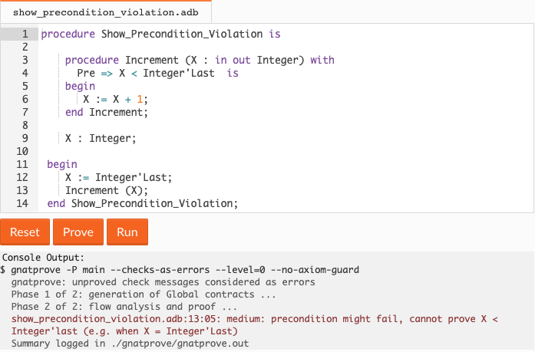
Running the SPARK Prover.
When you run the SPARK prover, it will identify the specific lines in your code that could cause bugs.
For example, here we are calling Increment with an argument that will cause the Pre check to fail.

Slide 26

Let’s Go to mlhlocal.host/learn-ada
Navigate to mlhlocal.host/learn-ada in your browser and go to Labs->Major League Hacking->Let’s Build a Stack
mlhlocal.host/MLHLearnAda
Raise your hand if you’re having any trouble!

Slide 27
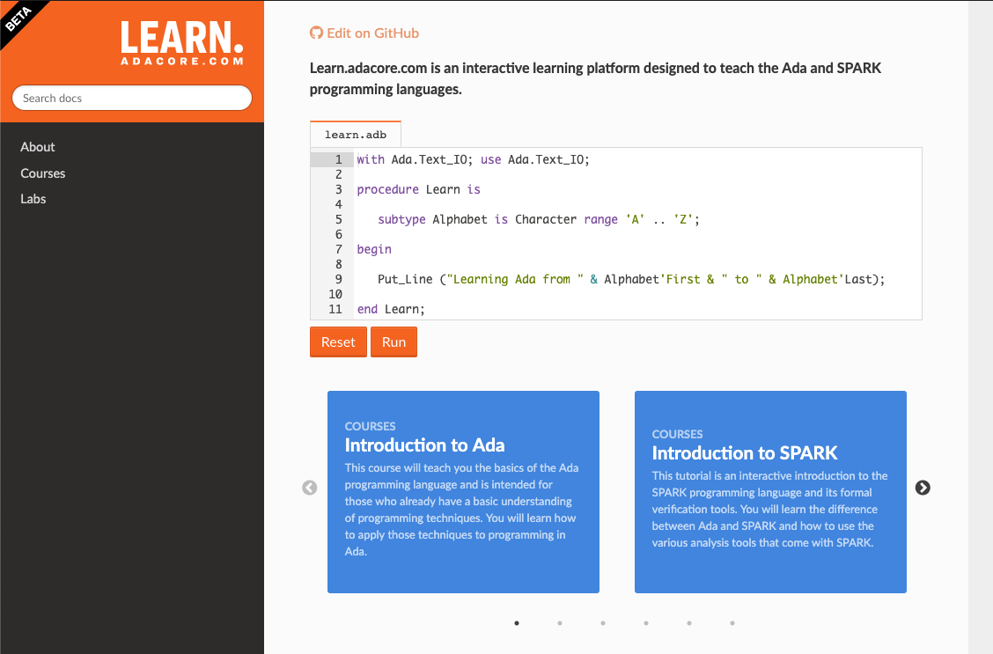
Meet mlhlocal.host/learn-ada
Learn Adacore is an interactive learning website designed to help you get started with Ada without installing any software.

Slide 28

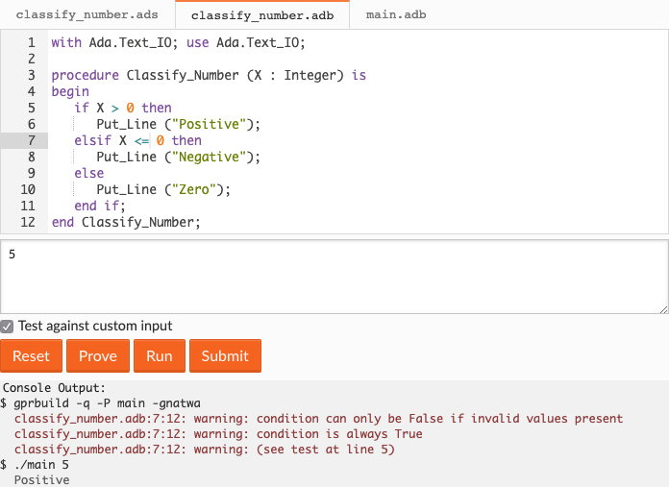
Use tabs to navigate between source files

Slide 29
The Reset button resets the editor back to the initial code

Slide 30
The Run button will run your code with the custom input as command line arguments
Check this box!

Slide 31
The Prove button runs the SPARK provers.
Warnings and errors will appear in the output window.

Slide 32
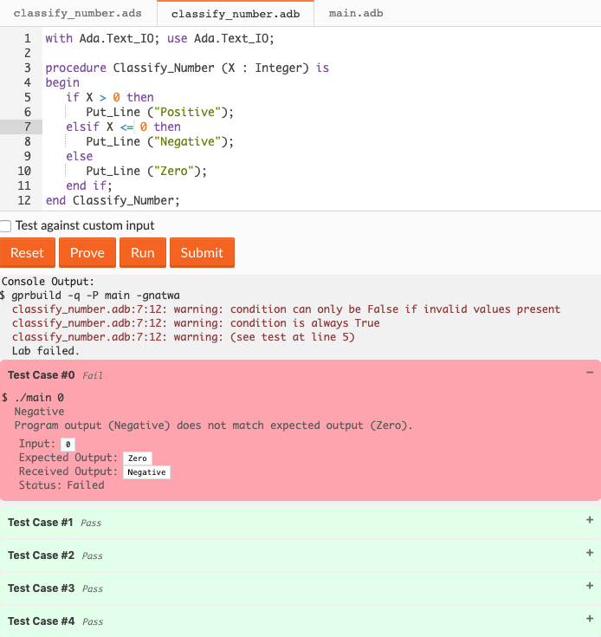
Submit your lab for grading using the Submit button.
Your test results will appear below.

Slide 34

What are we building today?
We’re building a Stack!
We’re going to build a common data structure called a “Stack”.
You’ll receive some sample code that’s mostly working with a few bugs.
We’ll use some of SPARK Ada’s cool features to find and fix the issues.

Slide 35


So, what is a Stack?
A Stack is like a pile of dishes...
The pile starts out empty.
You add (“push”) a new plate (“data”) onto the Stack by placing it on the top of the pile.
To get plates (“data”) out, you take the topmost one off the pile (“pop”).
Our stack has a maximum height (“size”) of 9 dishes.

Slide 36
Pushing items onto the stack.
Here’s what should happen if we
pushed the string “MLH” onto the stack.
Step 0:
Empty List
Step 1:
Push(‘M’)
Step 2:
Push(‘L’)
Step 3:
Push(‘H’)
Step 4:
Top
1:
1: M
1: M
1: M
1: M
2:
2:
2: L
2: L
2: L
3:
3:
3:
3: H
3: H
4:
4:
4:
4:
4:
5:
5:
5:
5:
5:
Last = 0
Last = 1
Last = 2
Last = 3
Last = 3
returns: ‘H’
The list starts out empty. Each time we push a character onto the stack, Last increments by 1.

Slide 37
Popping items from the stack.
Here’s what should happen if we
popped 2 characters off our stack & then clear it.
Step 0:
Starting List
Step 1:
Pop (Value)
Step 2:
Pop (Value)
Step 3:
Clear
1: M
1: M
1: M
1: M
2: L
2: L
2: L
2: L
3: H
3: H
3: H
3: H
4:
4:
4:
4:
5:
5:
5:
5:
Last = 3
Last = 2
returns: ‘H’
Last = 1
returns: ‘L’
Last = 0
Note that Pop & Clear don’t unset the array’s elements, they just change the value of Last.

Slide 38
Let’s Try the Program
The program is supposed to push values onto the stack, print the stack, and pop some values off the stack.
We can print the stack using the ‘d’ character.
We can pop a value off the stack using the ‘p’ character.
If we use any other character, it will be pushed onto the stack.
Consider the sequence: “M L H d p d”
This will:
1.) Push ‘M’ | 4.) Print the stack “M L H”
2.) Push ‘L’ | 5.) Pop the top item off the stack ‘H’
3.) Push ‘H’ | 6.) Print the stack “M L”

Slide 39
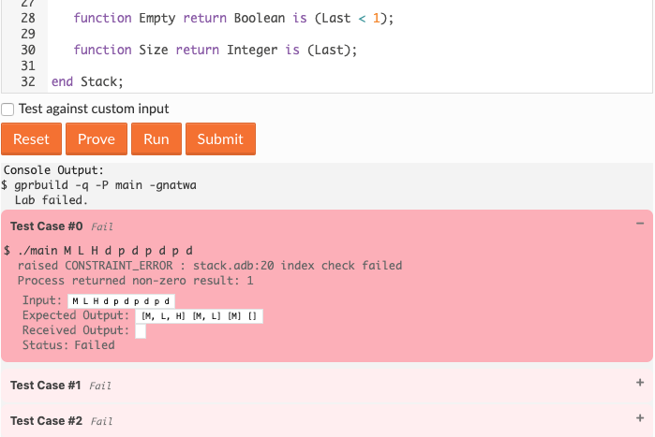
Let’s Try the Program
The program is supposed to push values onto the Stack. What happens when you try to submit the lab?
As you can see, the program crashes.
SPARK Ada can actually warn us before we compile though!

Slide 40
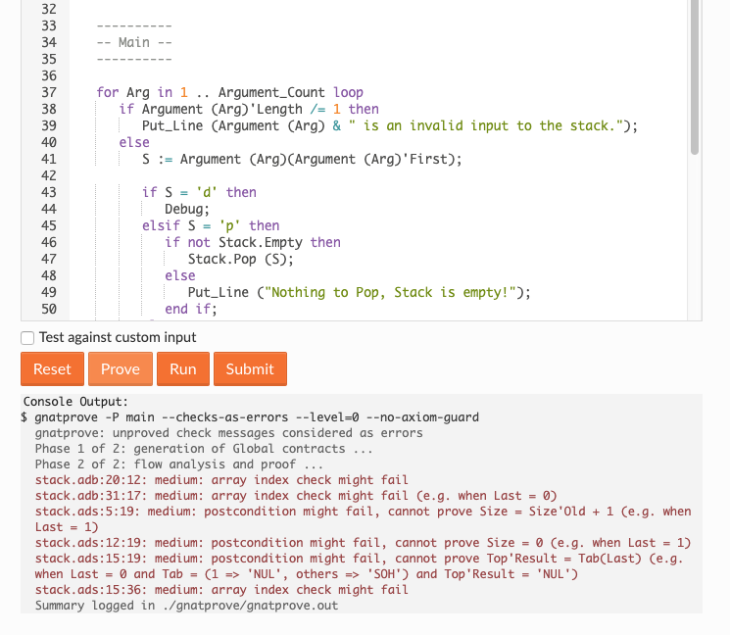
Using the Prover
If you press the Prove button, you’ll see the SPARK Prover identifies 6 issues with our code that may cause bugs or unexpected behavior.
Click on any item in the list to go to the
relevant section of the code.

Slide 41
Fixing our first bug.
Click on the warning from line 20 of stack.adb.
This is the code that handles “pushing” values onto the stack.
12
13
14
15
16
17
18
19
20
21
22
----------
-- Push --
----------
procedure Push (V : Character)
is
begin
Tab (Last) := V;
end Push;
Can anyone spot the bug in this code?
(Hint: It’s a logical bug, not a syntax bug)

Slide 42
Fixing our first bug.
Let’s draw out what happens when we push a value
onto the stack.
Step 0:
Empty Stack
Step 1:
Push(‘a’)
1:
1:
2:
2:
3:
3:
4:
4:
5:
5:
Last = 0
Last = 0
Look, Last never changes! We try to insert ‘a’ at index 0 of the Tab array, which raises an index out of bounds exception.

Slide 43
Fixing our first bug.
To fix the bug, we need to increment Last by 1
before adding V to the Tab array.
12
13
14
15
16
17
18
19
20
21
22
23
----------
-- Push --
----------
procedure Push (V : Character)
is
begin
Last := Last + 1;
Tab (Last) := V;
end Push;
>>
Going forward, line numbers will assume you’ve made
the changes as we identify them.

Slide 44
Fixing our first bug.
Now let’s draw out what happens when we push a few values
onto the stack with our new code.
Step 0:
Empty Stack
Step 1:
Push(‘a’)
Step 2:
Push(‘b’)
1:
1: a
1: a
2:
2:
2: b
3:
3:
3:
4:
4:
4:
5:
5:
5:
Last = 0
Last = 1
Last = 2
As we push new values, Last increments to refer to the slot in the Tab array with the most recent value.

Slide 45
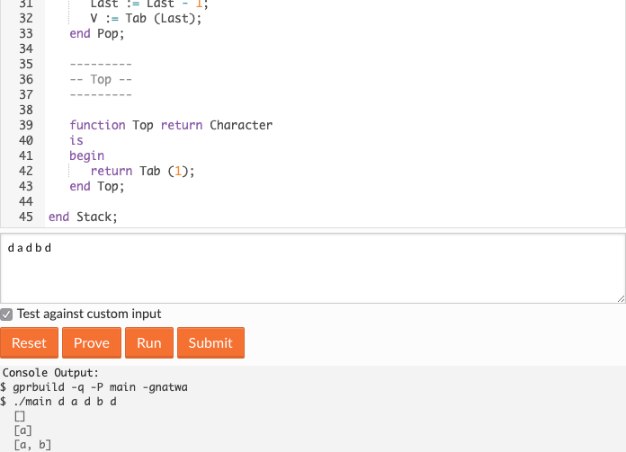
Fixing our first bug.
If you run the program again, you can now push new values onto the stack without any issue.
While you’re at it, run the SPARK prover again to verify that our total warning count has gone down to 5.
Notes:
So, you can still build and run your program using the Ada compiler, even if the SPARK prover can not verify it.
What this means is that your program is valid Ada code, but is not valid SPARK Ada code.

Slide 46
Fixing the Pop procedure.
Next, let’s look at the warning on line 32 of the Pop procedure.
The warning is “array index check might fail”.
23
24
25
26
27
28
29
30
31
32
33
34
---------
-- Pop --
---------
procedure Pop (V : out Character)
is
begin
Last := Last - 1;
V := Tab (Last);
end Pop;
Can anyone spot the bug in this code?
(Hint: It’s a logical bug, not a syntax bug)

Slide 47
Fixing the Pop procedure.
Let’s draw out what happens when we Push a few values
onto the stack & then Pop them off.
Step 0:
Empty Stack
Step 1:
Push (‘a’)
Step 2:
Push (‘b’)
Step 3.1:
Pop (Value): Last := Last-1;
Step 3.2:
Pop (Value):
V := Tab (Last)
1:
1: a
1: a
1: a
1: a
2:
2:
2: b
2: b
2: b
3:
3:
3:
3:
3:
4:
4:
4:
4:
4:
5:
5:
5:
5:
5:
Last = 0
Last = 1
Last = 2
Last = 1
Last = 1
V = ‘a’
Look, Last is decremented before we set V’s value.
We always get the 2nd-to-last item back from Pop.

Slide 48
Fixing the Pop procedure.
Swap lines 29 & 30 to set V’s value before we decrement Last.
23
24
25
26
27
28
29
30
31
32
33
34
---------
-- Pop --
---------
procedure Pop (V : out Character)
is
begin
V := Tab (Last);
Last := Last - 1;
end Pop;
>>
>>
What happens when you run the prover now?

Slide 49
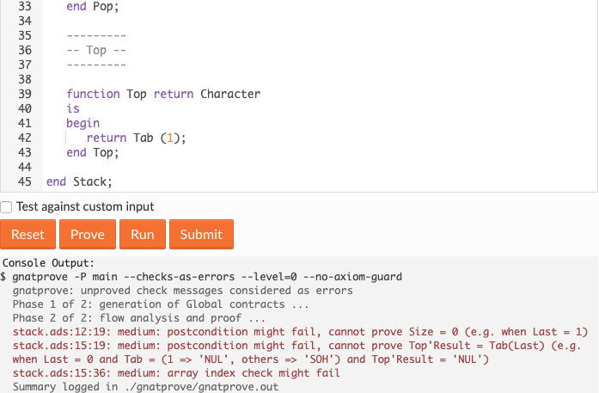
We’re down to 3 warnings!
When we run the prover now, we only get 3 warnings.
All three come from the Stack package’s specification file (stack.ads).

Slide 50
Fixing the Clear procedure.
Click on the warning from line 12 in stack.ads.
stack.ads:
10
11
12
13
procedure Clear
with Post => Size = 0;
The SPARK Prover can’t assert that Size will equal 0
after the Clear procedure has been run.
Can anyone figure out why?

Slide 51
Fixing the Clear procedure.
The code on line 11 of stack.ads corresponds to
the code on line 7 of stack.adb.
stack.ads:
10
11
12
13
procedure Clear
with Post => Size = 0;
stack.adb:
03
04
05
06
07
08
09
10
11
-----------
-- Clear --
-----------
procedure Clear
is
begin
Last := Tab’First;
end Clear;

Slide 52
Fixing the Clear procedure.
The Size function is also defined in stack.ads on line 30.
stack.ads:
10
11
12
13
procedure Clear
with Post => Size = 0;
stack.ads:
29
30
31
function Size return Integer is (Last);
It simply returns the value of Last.
So, when the stack is cleared, it should return 0.

Slide 53
Fixing the Clear procedure.
Let’s draw out what happens when we Push a few values
onto the stack & then Clear it.
Step 0:
Empty List
Step 1:
Push (‘a’)
Step 2:
Push (‘b’)
Step 3:
Push (‘c’)
Step 4:
Clear
1:
1: a
1: a
1: a
1: a
2:
2:
2: b
2: b
2: b
3:
3:
3:
3: c
3: c
4:
4:
4:
4:
4:
5:
5:
5:
5:
5:
Last = 0
Last = 1
Last = 2
Last = 3
Last = 1
In Step 4, Last is set to Tab’First,
which is the first index of the array - 1 not 0!

Slide 54
Fixing the Clear procedure.
The code on line 11 of stack.ads corresponds to
the code on line 7 of stack.adb.
stack.adb:
03
04
05
06
07
08
09
10
11
-----------
-- Clear --
-----------
procedure Clear
is
begin
Last := Tab’First - 1;
end Clear;
>>
Now Last will be set to 0 when we Clear the stack.

Slide 55
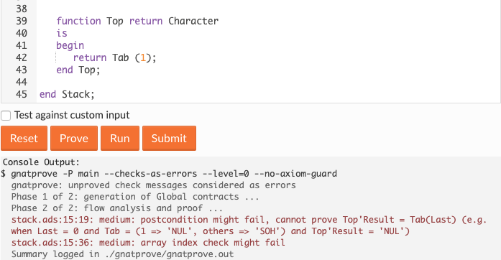
We’re down to our last warnings!
When we run the prover now, we only get 2 warnings.
Both point to line 15 of the specification - stack.ads.

Slide 56
Fixing the Top function.
Top returns the item at the top of the stack without popping it.
Can anyone spot the bug?
stack.ads:
13
14
15
16
procedure Top
with Post => Top'Result = Tab(Last);
stack.adb:
35
36
37
38
39
40
41
42
43
-----------
-- Top --
-----------
function Top return Character
is
begin
return Tab (1);
end Top;

Slide 57
Fixing the Top function.
Although 1 is technically the top (first element) of the
Tab array, the top of the stack is actually Last.
stack.adb:
35
36
37
38
39
40
41
42
43
-----------
-- Top --
-----------
function Top return Character
is
begin
return Tab (Last);
end Top;
>>
What happens when you run the prover now?
We should be all out of warnings, right?

Slide 58
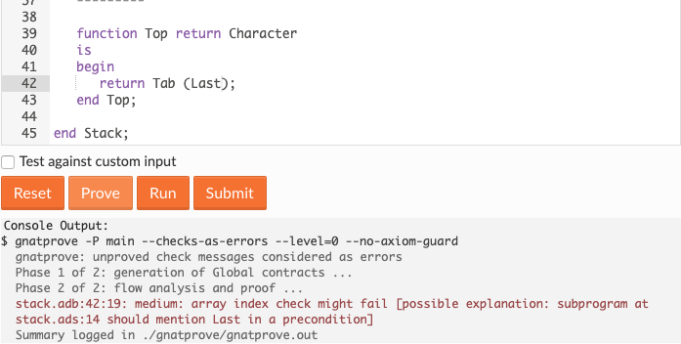
Surprise! We’ve got one more warning to fix.
The SPARK Prover recognizes that if Last = 0,
Top would throw an index out of bounds error.
Hint: If Post specifies conditions after a function runs,
how would you specify conditions before?

Slide 59
Fixing the final warning.
We can use Pre conditions to specify that
Top can’t be called when the stack is empty.
stack.ads:
13
14
15
16
17
function Top return Character
with Post => Top'Result = Tab(Last),
Pre => not Empty;
>>
stack.ads:
28
29
30
function Empty return Boolean is (Last < 1);

Slide 60
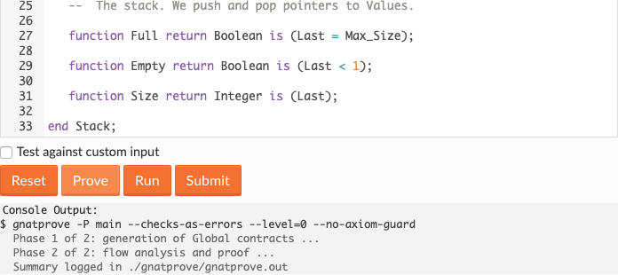
Our code is bug-free!
Thanks to the SPARK Ada Prover, our code is proven to not raise exceptions, use uninitialized variables, and more!
Run the prover on your code to see for yourself.
Raise your hand if you need help or are still getting warnings!

Slide 61
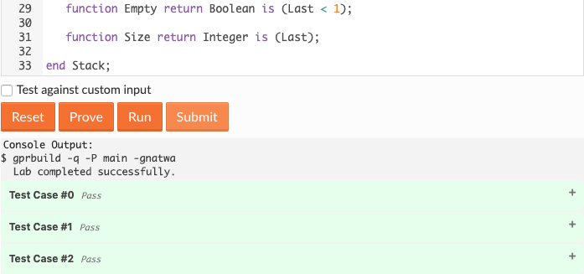
Try submitting the program yourself!
Now that our program works,
Try submitting it by clicking “Submit”.

Slide 63
Let’s recap quickly...
1
SPARK Ada makes it easy for you to write bug-free programs!
2
Ada is a modern language that you can use on a variety of systems for a variety of purposes.
3
Employers are looking for developers that can engineer robust software & Ada enables that!

Slide 64
What did you learn today?
We created a fun quiz to test your knowledge and see what you learned from this workshop.
http://mlhlocal.host/quiz

Slide 66
Where to go from here...
1
Explore the differences between Ada, C++, & Java. http://mlhlocal.host/adacore-ada-vs-java
2
Keep learning Ada & SPARK. http://mlhlocal.host/learn-ada
3
Complete the additional practice problems. These problems & way more are in your email!

Slide 67
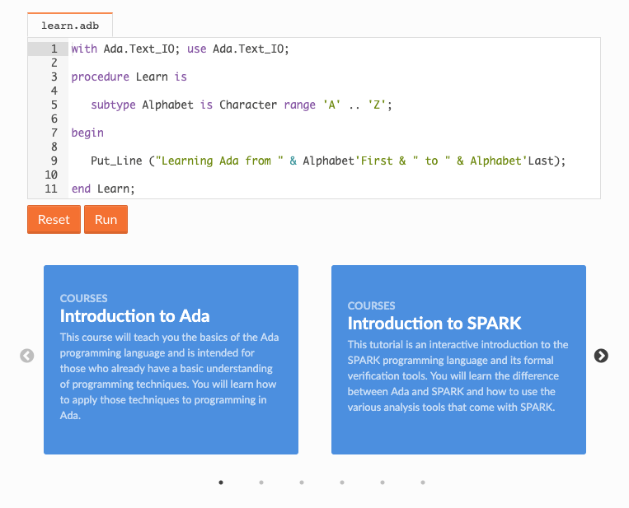
Keep Learning Ada and SPARK
Introduction to Ada and Introduction to SPARK
Learn more about Ada and SPARK with the Introduction to Ada and Introduction to SPARK courses on learn.adacore.com. You can also try your new Ada and SPARK skills by visiting the labs section.

Slide 68

Learning shouldn’t stop when the workshop ends...
Check your email for access to:
These workshop slides
Practice problems to keep learning
Deeper dives into key topics
Instructions to join the community
More opportunities from MLH!

Slide 69
v.0.0.2

